Slide 1
Spring Hackathon

Slide 2
Outcomes
Understand what Docker is and run a containerised web app
Explore a React frontend and how it communicates with a Python backend
Train and visualise a model of your choice on a timeseries problem

Slide 3
Important information
This is not a "competitive" hackathon
Have fun with it
Limit AI use

Slide 4
Tools

Slide 5
What is Flask?
A lightweight Python web server.
It listens for requests from the browser and sends back data or pages.
@app.route("/")
def index():
return render_template("index.html")

Slide 6
What is React?
A JavaScript library for building user interfaces.
Instead of manually updating the page, you just update your data and React updates the
page automatically.
const [results, setResults] = useState([]);
When results changes, the charts re-render — no extra code needed.

Slide 7
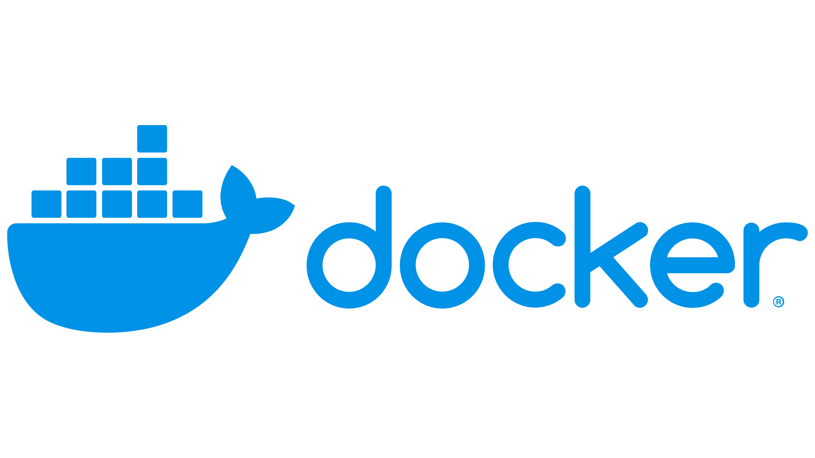
What is Docker?
A tool that packages your app and everything it needs to run into a single container.
Think of it like a box — open it on any machine and it just works.
Two main files
  A Dockerfile — instructions for building the container
  A docker-compose.yml — shortcut to run it

Slide 8
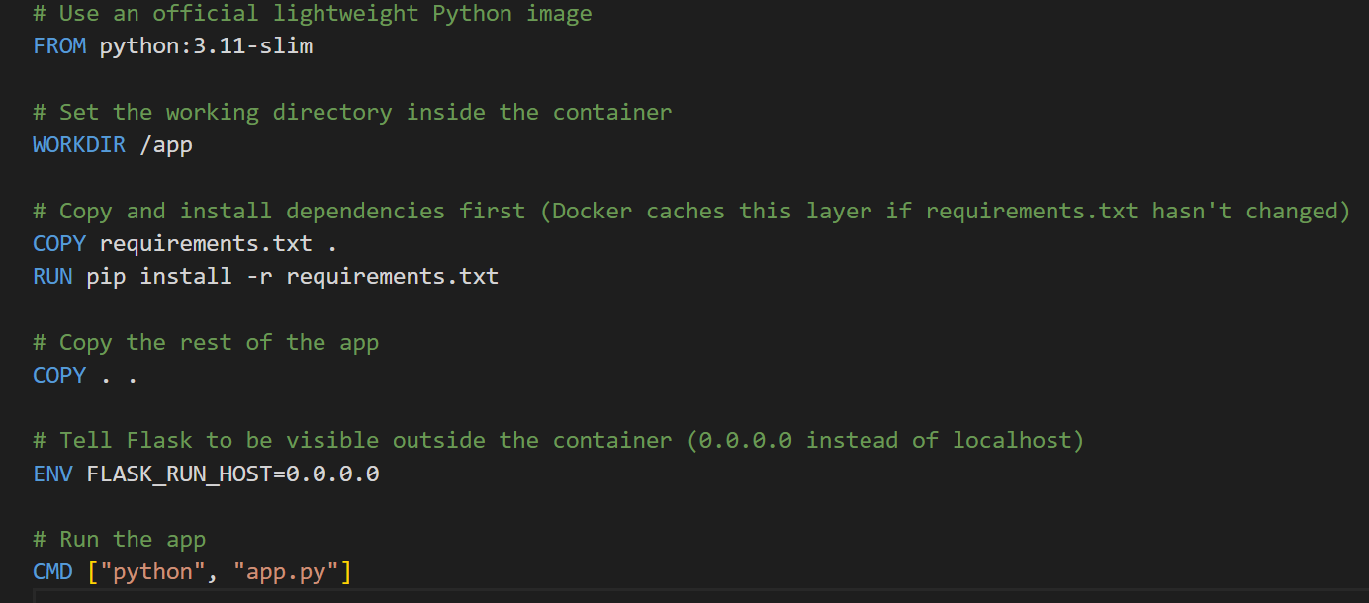
Dockerfile
A Dockerfile — instructions for building the container

Slide 9
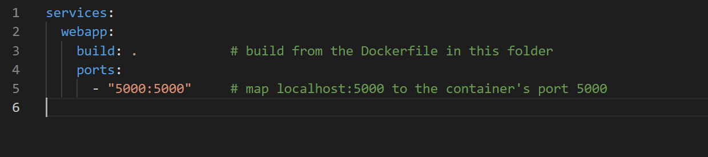
docker-compose.yml
A docker-compose.yml — shortcut to run it

Slide 10
What is XGBoost?
A powerful machine learning algorithm that builds many small decision trees, each one learning from the mistakes of the last.
The result is a strong model built from many weak ones (known as boosting).
One of the most popular algorithms for structured data.
Sample: [feature0, feature1, feature2, feature3,feature4]
Tree 1
feature2 > 0.5?
yes
no

Slide 11

The data

Slide 12
Direction?
Does the amount of pesticide work as a good input for yield forecasting?
Can we use temperature to help predict a countries rainfall, can this predicted data then be used as an input for a yield prediction model?
Does a model trained on global data perform better at predicting country X's yield rather than a model trained only on country X?
Is the above effected by model choice?

Slide 13
Groups!
Group 1 Jack Davis Athinoulla Konstantinou James Nelson Videsh Jagroo Seyi Ibigbemi Poppy Ferguson | Group 2 Dominik Bittner Becca Morrell-Tomiczek Yiyuan Wang Jack MacKenzie John Callaghan Georgie Fletcher
Group 3 Aura Anderson-Ross Alisa Holm Arkan De Lomas Abena Nkansah Albor Meha | Group 4 Villanelle O'Reilly Lauren Gilman James Barnard Maddison Parkhouse Adam Hale

Slide 14
Example Code
The repo:
SUSTAIN-CDT/TimeseriesHackathon: Timeseries Hackathon example project.

Slide 15
How to run it
Install docker on your computer
Windows | Docker Docs
Make sure Docker is running
Navigate to the folder in your console and run:
docker compose up –build
In your browser go to
http://localhost:5000/

Slide 16
If I was you...
Study the example code
Create new routes and functions to test you understand how the app functions
  Online documenation for Flask and React are fantastic
Get the provided data working with the provided XGBoost model
XGBoost has no temporal awareness by default. It treats every row as an independent sample. Look at how it can be windowed, how does this affect perfromance
Investigate other models Random Forest, LSTM, Timeseries transformer models, Moirai.

Slide 17
The outcome
By the end of the week, we expect
  The Web app using the provided data to create forecasts of any kind
  Visuals of the reults presented on the web app
Any thing you try to explore which doesn’t work, or you didn’t finish, tell us!
  It's interesting to hear the story and challenges faced

